Slide 1
Business Process Engineering
Week 12

Slide 2
What Exactly is BPM or Business Process Modeling?
Businesses do not always operate efficiently, that could be the reason behind the reduced operational performance.
It becomes critical to improve, re-evaluate, and re-work the processes to ensure that the organization drives competitive advantage in the marketplace.

Slide 3
Business Process Modeling (BPM)
BPM (Business Process Modeling) involves representing a company’s workflows or processes in a graphical way. That includes the use of a data-flow diagram, flowcharts, and more.
With BPM, the company maps out the state of processes as they are now and comes upon with a model of the future state after making improvements.
These are the As-is state and To-be state.

Slide 4
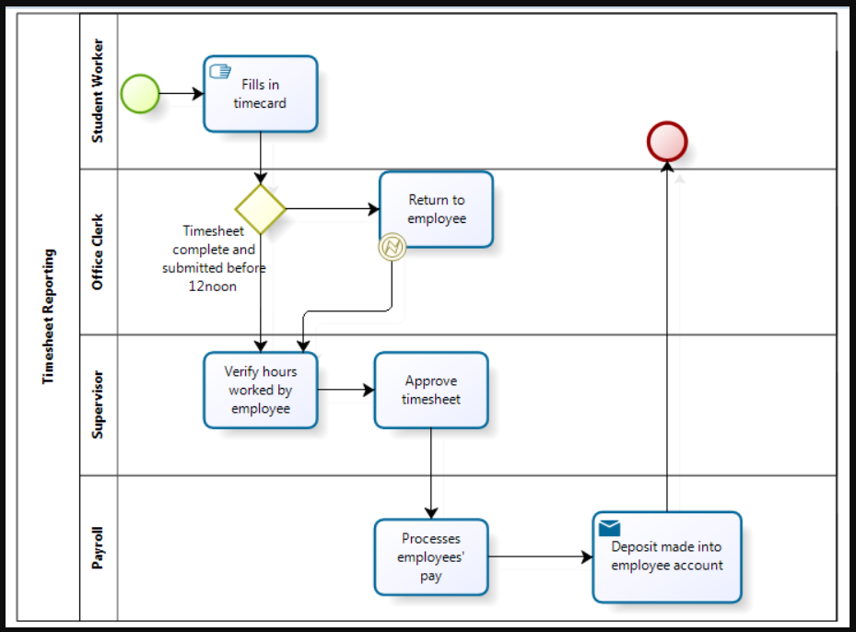

Slide 5
Business Process Modeling
1- Model the existing process
2- Determine Weakness and Possible Areas of Improvement
3- Come Up With the Design To Be Process

Slide 6
BPI (Business process improvement)
BPI (Business process improvement) is an exercise in which leaders use different methods to analyze their procedures.
That helps them determine areas they can improve in regard to efficiency, accuracy, or effectiveness.
Later they can redesign the processes to notice the changes.
BPI seeks to identify the skills or operations that require improvement to promote smooth operation, effective workflow, and business growth.

Slide 7
BPI Methodologies
Lean management
Six sigma
Agile management
Kaizen
Total quality management

Slide 8
What is Business Process Re-engineering?
BPR (Business Process Re-Engineering) involves recreating a core business process. The goal is to reduce costs and improve product quality and output.
Business process re-engineering has now become an alternative to business process management that involves reusing or automating existing processes.
Note that BPR is not downsizing, restructuring, reorganizing, cost-cutting, or automation.

Slide 9
What is Business Process Re-engineering?
It’s crucial to have some things in mind when implementing business process re-engineering. These include:
Identifying goals and purposes
Having the company’s vision and mission in mind
Inventing a new process if the older one no longer works
Implementing simple and optimized processes
Changing focus from management to customers
Focusing on the end result

Slide 10
What is Business Process Engineering
BPE (Business Process Engineering) is the study of business processes to streamline and improve efficiency on cost and performance.
BPE focuses on new processes, diagnosing problems with an organization’s current methodology, and reconstructing, redesigning, and monitoring processes to ensure effectiveness.

Slide 11
What is Business Process Re-engineering?
Knowing the Present Mode of Operation
Deciding the Future Mode of Operation
Gap Analysis and Transition Plan
Implementation

Slide 12
BPM vs. BPI
A BPM project involves modeling, execution, monitoring, and improvement, while a BPI lifecycle involves modeling, monitoring, and improvement.
The difference between the two lies in the execution step.
BPI skips on the execution step.

Slide 13
BPI vs. BPR
You may have noticed BPI and BPR being interchanged in an organization, but the differences lie in the depth of change.
Business process re-engineering involves changing the process completely to achieve different results, which is the opposite of what business process improvement focuses on.
BPI involves tweaking an already existing process to achieve a better result.

Slide 14
BPI vs BPE
Business process engineering’s main focus is on new business processes.
That means diagnosing problems with the current methodology, redesigning, reconstructing, and monitoring processes to make sure they are functional and effective.
However, business process improvement involves redesigning an existing business operation to achieve significant improvement in production.
BPI focuses on customer and operational efficiency.
Moreover, business process engineering means implementing new technologies into an organization to create effective and automated processes.
Business process improvement on the other hand seeks to reduce variation in processes to achieve the desired outcome.

Slide 15
Lean software development
Lean software development is a translation of Lean manufacturing and Lean IT.
principles and practices to the software development domain. Adapted from the Toyota Production System.
Lean is an Agile methodology which can also be seen as a philosophy.
The core idea is to maximize customer value while minimizing waste. Simply, lean means creating more value for customers with fewer resources.

Slide 16
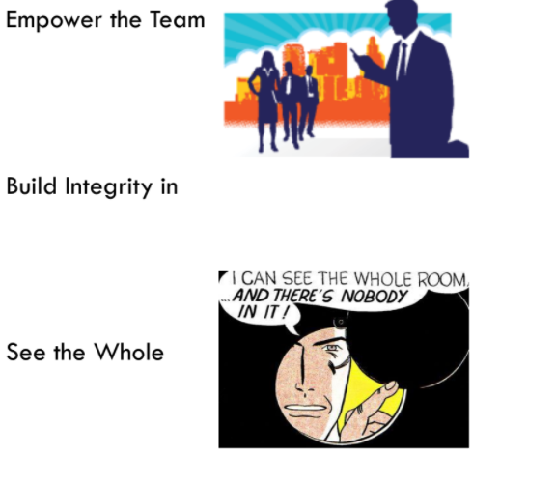
Lean principles

Slide 17
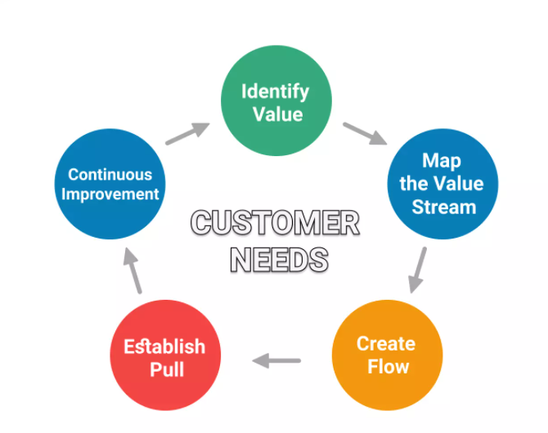
Applying Lean in Project Management?

Slide 18
1. Identify Value from Your Customers’ Perspective
Identifying value means working to deliver what your customers need instead of what they simply asked for.
Lean project managers identify and specify value from the customers’ perspective by identifying objectives, requirements, deliverables, and acceptance criteria.
Further on, in Lean, any activity that is not directed at solving the problem and delivering the project's end result is seen as wasted resources.

Slide 19
2-Value Stream Mapping
In traditional project management, the next step will be to create a project plan with a work breakdown structure and tasks.
The goal of the map is to show how and where in your organization/team value is being generated.
it will clarify your overall process, so you can identify flaws or unnecessary steps and eliminate them.

Slide 20
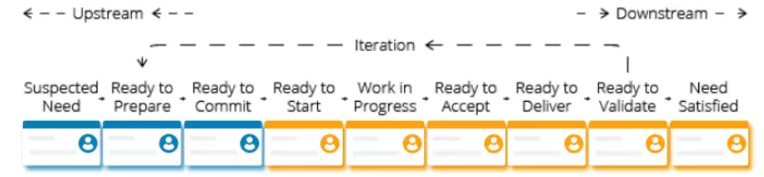
2-Value Stream Mapping

Slide 21
3.Create Continuous Workflow
You have identified the value your customer is seeking to receive, and you have also mapped how you are producing it.
As next, the focus is on ensuring the project can flow smoothly, without interruptions, blockages, or waiting times through your system.
Lean defines waste as any process step that consumes resources but brings no value from the customers’ perspective

Slide 22
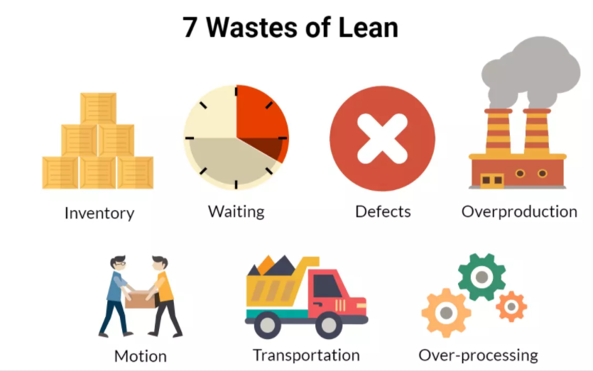
Waste

Slide 23
Inventory – typical example of inventory waste is overstocking to meet unexpected demand. In project management, often seen inventory waste is purchased online tools that teams rarely use or office supplies that exceed needs.

Slide 24
Waiting – whenever a task is not moving, the waste of waiting occurs, interrupting the continuous workflow. Typical in project management is waiting for approval from higher management.

Slide 25
Defects – causing rework or even scrap, defects are hazardous waste. Examples from the project management world would be incorrect data collection, conversation errors, and unclear acceptance criteria.

Slide 26
Overproduction - occurs when you exceed customer demand and produce more than is needed or before it is needed. It is also a hazardous waste type, as it triggers the other six wastes. Overproducing in project management would mean filling an unnecessary great amount of documents or communicating unnecessary information.

Slide 27
Motion – to avoid motion waste, you need to arrange a process where workers need to do as little as possible to finish their job. Often in project management, motion waste is generated by searching for information or lack of direct access to data.

Slide 28
Transportation – transportation is wasteful whenever you move resources without this movement generating value to the end product. Task switching, interruptions, unnecessary outsourcing are prime examples of transportation waste in the project management reality.

Slide 29
Over-processing – often manifested as double work or work exceeding customer requirements. In project management, we see over processing most often as multiple levels of approval for small tasks, excessive reviews, or too many iterations.

Slide 30
Bottleneck
Eliminating these sources of waste from your process will allow the value to flow through your project freely. However, to ensure a continuous workflow, you also have to look out for bottlenecks.
A bottleneck is a stage of your work process where work gets stuck due to capacity shortages. You have a bottleneck when a work stage, even working at its full capacity, still would not manage to process work items quickly enough. As a result, continuous flow is interrupted.

Slide 31
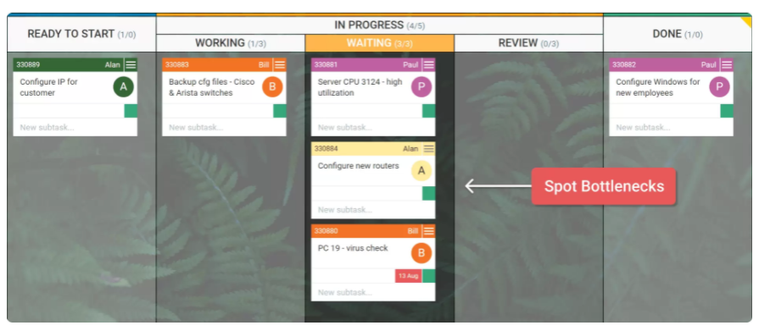

Slide 32
4. Create a Pull System
A pull system is characterized by work entering the workflow only when there is a demand for it.
No work item is being started before there is an actual need for it.
This way, a pull system avoids building up waste during your project and supports its efficiency and predictability.
However, speaking about workflow management, a pull system also means your team members can pull work items only when they have free capacity.
Such a system allows you to prioritize work better and start your next task when you can really work on it.

Slide 33
WIP Limits
To better control your “Pull” work system, you can introduce Work in Progress Limits.
Limiting the maximum amount of work items in the different stages of the work process minimizes multitasking and context switching. It allows team members to focus on the particular task and to complete it faster.
WIP Limits also regulate new work to be pulled into a particular work stage, only when capacity is available. This way, no tasks are being pushed over, and interruptions or overburdening are minimized.

Slide 34
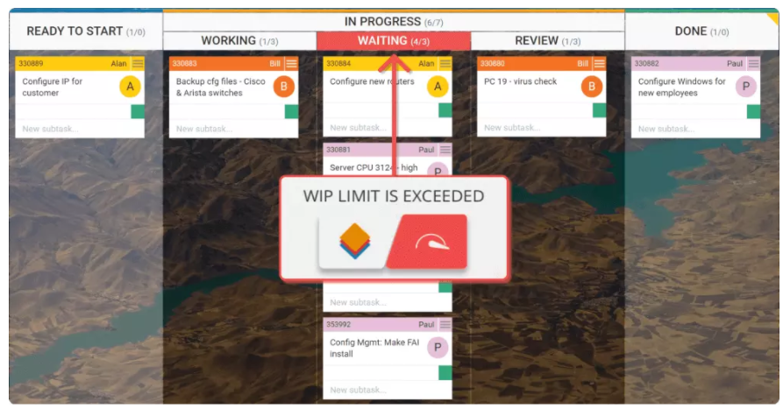

Slide 35
5. Continuous Improvement
With continuous improvement, you embrace the fact that your work system is not static and will always offer space for improvement.
It is important to underline, this should not be seen as the last step of a project. Moreover, it is something you do with every step.
you will transform your organization into a continuous learning system.

Slide 36
Lean Management Tools
Integrating the Lean principles into your project management routine will not happen overnight and without a dedicated effort from the whole team or organization

Slide 37
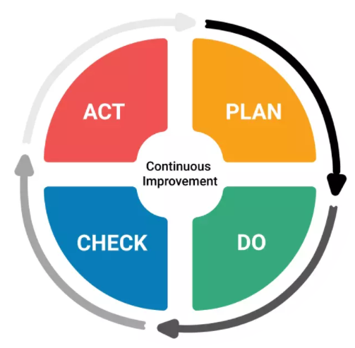
PDCA in Lean Project Management
Also known as the Deming Cycle, the Plan-Do-Check-Act cycle is a key instrument of the lean manufacturing toolkit.

Slide 38
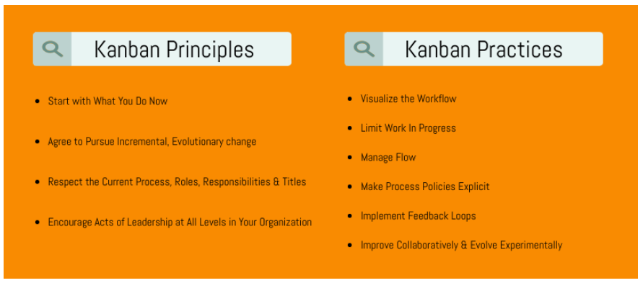
Kanban
Kanban is one of the most widely spread workflow management methods that helps you visualize your work, improve your workflow, and ultimately increase your efficiency.

Slide 39
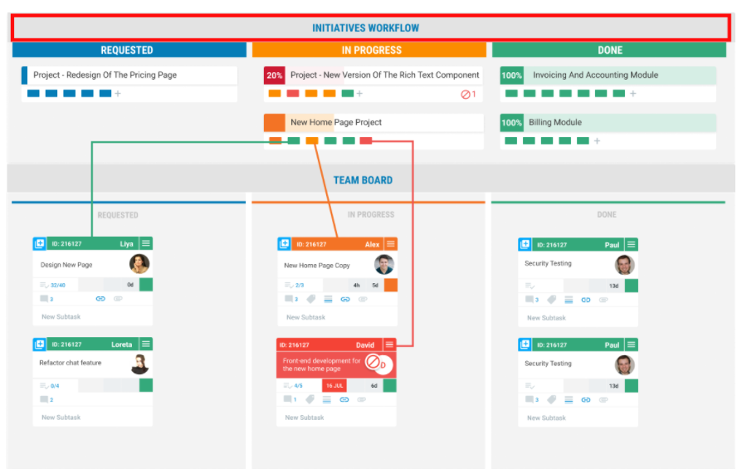

Slide 40
Kaizen and Kairyo
Kaiyro and Kaizen represent the combination of continuous self-development efforts on a personal level and the continuous improvement efforts on a team and organization levels that can result in actual performance and efficiency improvements.

Slide 41
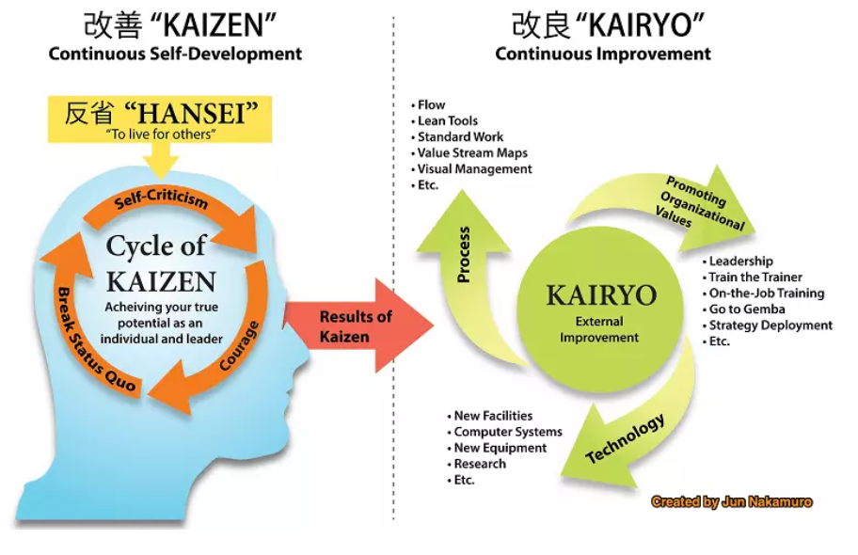

Slide 42
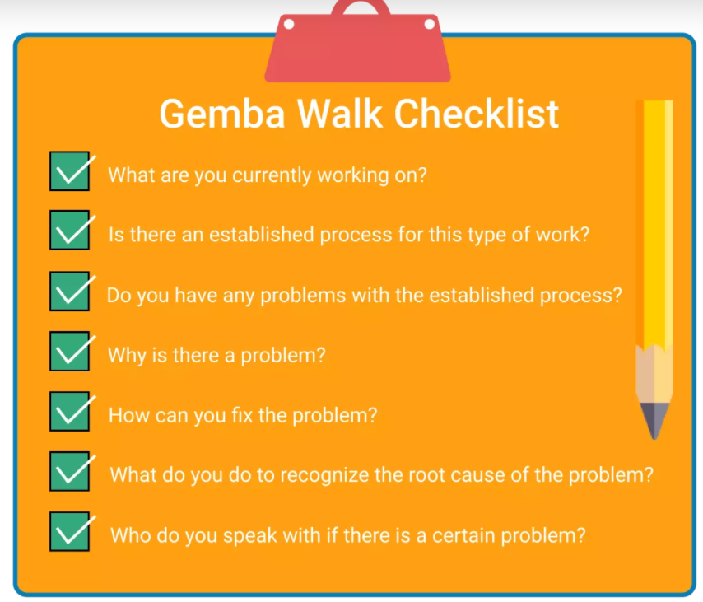

Slide 43
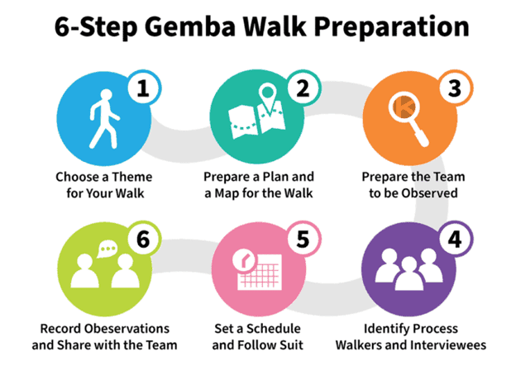

Slide 44
Lean Project Management in a nutshell
Lean Project Management requires to look at your project as a value stream
It is focused on value delivery from the customers perspective, cutting down project waste to optimize efficiency and continuously improving the project process to increase customer satisfaction
Contrary to traditional project management, Lean does not distinguish between project phases. The focus is on following the five core principles of Lean management cyclically.
Eliminating project waste and creating a pull system is central to increasing the efficiency of your projects.
One of Lean project management's main goals is to create a stable workflow - to make the project delivery uninterrupted and by that predictable.
Choosing and combining different Lean Management tools like a PDCA cycle, Kanban board, and Gemba checklist will support the transition from traditional to Lean project management

